Slide 1
What is CMMC?
Slide Classification: Classification goes here
Cybersecurity Maturity Model Certification (CMMC) is a DoD framework that sets standardized cybersecurity requirements for companies in the Defense Industrial Base (DIB) to protect sensitive government information. The purpose of the CMMC program is to protect Federal Contract Information (FCI) and Controlled Unclassified Information (CUI) from cyber threats.
Federal Contract Information (FCI): Information, not intended for public release, that is provided by or generated for the Government under a contract to develop or deliver a product or service to the Government. It does not include information provided by the Government to the public, such as on public websites, or simple transactional information, such as information necessary to process payments.
Controlled Unclassified Information: Information the Government creates or possesses, or information an entity creates or possesses for or on behalf of the Government, that a law, regulation, or Governmentwide policy requires or permits an agency to handle using safeguarding or dissemination controls.

Slide 2
CMMC Levels
Slide Classification: Classification goes here
CMMC Level 1: Level 1 is primarily designed to protect FCI which is basic information, not intended for public release, that the Government collects, develops, uses, or is provided when performing a contract.
Annual self-assessment and annual affirmation of compliance with the 15 security requirements in FAR clause 52.204-21
CMMC Level 2: Level 2 is designed to protect CUI as defined as information that the Government creates or possesses, or information an entity creates or possesses for the Government, and requires safeguards. Either a self-assessment or a C3PAO third party assessment is required every three years, as specified in the solicitation
Decided by the type of information processed, transmitted, or stored on the contractor or subcontractor information systems
Annual affirmation verifying compliance with the 110 security requirements in NIST SP 800-171 Revision 2
CMMC Level 3: Level 3 is designed to protect CUI against advanced persistent threats when the information is highly sensitive and could harm national security if leaked.
Undergo an assessment every three years by the Defense Contract Management Agency’s Defense Industrial Base Cybersecurity Assessment Center (DIBCAC)
Provide an annual affirmation verifying compliance with the 24 identified requirements from NIST SP 800-172

Slide 3
Expected DLA Procurements with CMMC
Slide Classification: Classification goes here
DLA Supply Class Number | DLA Supply Class Description | Expected CMMC Levels with Percentages in Supply Class
Class I | Subsistence, including food and food-related supplies, including condiments, utensils, paper products, and bottled water | Level 2 Self (95%) Level 2 C3PAO (5%)
Class II | Clothing, individual equipment, tentage, organizational tool kits, and hand tools | Level 2 Self (70%) Level 2 C3PAO (30%)
Class III | Petroleum fuels, lubricants, hydraulic and insulating oils, preservatives, liquid and compressed gases, bulk chemical products, coolants, de-icing and antifreeze compounds, together with components and additives of such products, and coal | Level 1 (95%) Level 2 Self / C3PAO (4%) Level 3 (1%)
Class IV | Construction materials including installed equipment and all fortification or barrier materials | Level 2 Self (72%) Level 2 C3PAO (28%)
Class VIII | Medical materiel, including medical-peculiar repair parts | Level 2 Self (98%) Level 2 C3PAO (2%)
Class IX | Repair parts and components including kits, assemblies and subassemblies, and reparable and consumable items required for maintenance support of all equipment, excluding medical-peculiar repair parts | Level 2 Self (77%) Level 2 C3PAO (23%)
Service Contracts | Includes service contracts from DCSO, Disposition, and Distribution for basic supplies or services (non-technical), services, logistics IT/system integration. | Level 1 (1%) Level 2 Self (12%) Level 2 C3PAO (73%) Level 3 (10%)
https://www.dla.mil/Small-Business/Resource-Center/Cybersecurity-Resources/#SupplyClassestoCMMCLevels

Slide 4
DoW Phased Implementation Plan
Slide Classification: Classification goes here
Phase 1 – Initial Implementation
Phase 2
Begins at 48 CFR
Rule Effective Date,
10 Nov 25
*When applicable, solicitations and contracts will require Level 1 (Federal Contract Information (FCI)) or Level 2 Self-Assessment (CUI/CDI)
Begins 12 months after Phase 1 start,
10 Nov 26
*When applicable, solicitations and contracts will require Level 2 C3PAO Assessment (CUI/CDI)
Phase 3
Phase 4 – Full Implementation
Begins 24 months after Phase 1 start,
10 Nov 27
*When applicable, solicitations and contracts will require Level 3 DIBCAC Assessment (CUI/CDI)
Begins 36 months after Phase 1 start,
10 Nov 28
All solicitations and contracts will include applicable CMMC Level requirements as a condition of contract award
https://www.dla.mil/Small-Business/Resource-Center/Cybersecurity-Resources/#PhasedImplementation

Slide 5
DLA Plan of Action
Slide Classification: Classification goes here
DLA is implementing CMMC using a three-year phased approach beginning November 10, 2025, in alignment with DoW guidance. Upon full implementation, on or after November 10, 2028, suppliers are required to achieve, at time of award, a CMMC status at the level specified in the solicitation, or higher, for all information systems used in the performance of the contract, task order, or delivery order that will process, store, or transmit FCI or CUI. Suppliers are required to maintain a current CMMC status at the specified CMMC level or higher, if required by the contract, task order, or delivery order, throughout the life of the contract, task order, or delivery order.
The program office or requiring activity is responsible for determining the applicable CMMC level based on the sensitivity and criticality of the information handled.
Important: DLA suppliers are highly encouraged to complete a CMMC assessment during the phase-in period ahead of full implementation.
Phase | Date | Description
Phase 0: Preparation & Awareness | Prior to Nov 9, 2025 | DLA and suppliers prepare for CMMC integration. DLAD development. No mandatory CMMC clause yet.
Phases 1-3: Optional Provision / Clause Inclusion | Nov 10, 2025 – Nov 9, 2028 | Contracting officers may include CMMC requirements in solicitations if determined by requiring activity. Applies to contracts involving FCI/CUI, excluding COTS-only awards. Conduct training, system considerations, and awareness campaigns.
Phase 4: Mandatory Provision / Clause Inclusion | Nov 10, 2028 – onward | CMMC provision and clause included in applicable solicitations and contracts where contractor systems process, store, or transmit FCI/CUI. Excludes COTS-only awards. Supplier Certifications must be current and maintained throughout contract lifecycle

Slide 6
How to observe the CMMC level (DoW-wide)
Slide Classification: Classification goes here
DFARS provision 252.204-7025 (b) (1) and DFARS clause 252.204-7021 (d) (1) (i)
Both provisions/clauses state the CMMC level for the specific solicitation/contract.
DoW Wide
DFARS provision 252.204-7025 (b) (1) | DFARS clause 252.204-7021 (d) (1) (i)
Cybersecurity Maturity Model Certification (CMMC) level. The CMMC level required by this solicitation is: ____________ [Contracting Officer insert: CMMC Level 1 (Self); CMMC Level 2 (Self); CMMC Level 2 (C3PAO); or CMMC Level 3 (DIBCAC)]. This CMMC level, or higher (see 32 CFR part 170), is required prior to award for each contractor information system that will process, store, or transmit Federal contract information (FCI) or controlled unclassified information (CUI) during performance of the contract. | Have and maintain for the duration of the contract a current CMMC status at the following CMMC level, or higher: ____________ Contracting Officer insert: CMMC Level 1 (Self); CMMC Level 2 (Self); CMMC Level 2 (C3PAO); or CMMC Level 3 (DIBCAC) for all information systems used in performance of the contract, task order, or delivery order that process, store, or transmit FCI or CUI; and

Slide 7
How to observe the CMMC level (DLA Specific)
Slide Classification: Classification goes here
Suppliers will see DLA Procurement Notes and/or DLA Standard Text Objects (STOs) in contracts indicating a current (now) or future (by Nov 10, 2028) requirement.
“…DLA is implementing CMMC using a three-year phased in approach beginning on the effective date of November 10, 2025. On November 10, 2025 suppliers requiring access to CTI technical data for a DLA procurement solicitation or contract have the option to upload a CMMC Level 2 Self-Assessment IAW DFARS CMMC Clause 252.204.7021 to the DoD Supplier Performance Risk System (SPRS). After November 10, 2028, suppliers must have a completed CMMC Level 2 Self-Assessment uploaded to SPRS to be eligible for this contract award...”
CMMC Level | Procurement Notes | Standard Text Objectives
Level 1 self assessment | L39 Cybersecurity Maturity Model Certification (CMMC)CMMC Level 1 Self-Assessment Requirement for Federal Contracting Information (FCI) | None
Level 2 self assessment | L40 Cybersecurity Maturity Model Certification (CMMC) Level 2 Self-Assessment Requirement | RD004: Cybersecurity Maturity Model Certification (CMMC) Level 2 Self-Assessment Phase In Requirement (November 10, 2025 – November 10, 2028.
Level 2 C3PAO | L41 Cybersecurity Maturity Model Certification (CMMC) Level 2 Certified Third-Party Assessment Organization (C3PAO) Requirement | RD005: Cybersecurity Maturity Model Certification (CMMC) Level 2 C3PAO Phase In Requirement (November 10, 2025 – November 10, 2028)
Level 3 | L42 Cybersecurity Maturity Model Certification (CMMC) Level 3 Defense Industrial Base Cybersecurity Assessment Center (DIBCAC) Assessment Requirement | None

Slide 8
Supplier Implementation
Slide Classification: Classification goes here
Inventory Assets and Data: Create a complete inventory of all users, devices, and cloud services. Map the flow of FCI or CUI through your systems to understand where it is stored and processed.
Implement Security Controls: Put the required security practices into action.
Develop a System Security Plan: This is a key document that explains how your organization meets the numerous security requirements. It is mandatory for compliance, and it includes policies and procedures regarding people, processes, and technology.
Documentation: Collect proof that your controls are working. This can include screenshots of security settings, system logs, or employee training certificates.
https://www.dla.mil/Small-Business/Resource-Center/Cybersecurity-Resources/#CMMCsteps

Slide 9
Self-assessment
Slide Classification: Classification goes here
Level 1 self assessments:
CMMC Level 1 Example Checklist
Project Spectrum website
Level 2 self assessments:
NIST SP 800-171 Protecting CUI in Nonfederal Systems and Organizations Requirements Spreadsheet
Project Spectrum website
Level 2 C3PAO assessment:
Review third party assessors on the Cyber AB website and choose provider
Level 2 self assessment checklist completed prior to third party assessment
DLA:
https://www.dla.mil/Portals/104/Documents/SmallBusiness/CMMCLevel1Checklist.xlsx?ver=KFawEWop5f00yIGisLr5FQ%3d%3d
PROJECT SPECTRUM:
https://www.projectspectrum.io/#/cyber-readiness-check
CYBER AB:
https://cyberab.org/Catalog#!/c/s/Results/Format/list/Page/1/Size/9/Sort/NameAscending
NIST: https://view.officeapps.live.com/op/view.aspx?src=https%3A%2F%2Fcsrc.nist.gov%2Ffiles%2Fpubs%2Fsp%2F800%2F171%2Fr2%2Fupd1%2Ffinal%2Fdocs%2Fsp800-171r2-security-reqs.xlsx&wdOrigin=BROWSELINK

Slide 10
Actions after assessment
Slide Classification: Classification goes here
After the assessment is complete, enter your results in Supplier Performance Risk System
Affirmations are required annually after each assessment.
Plan of Action and Milestones (POAMs) may be required for CMMC Level 2 self and C3PAO.
A POA&M closeout assessment is a CMMC assessment that evaluates only the NOT MET requirements identified in the initial assessment. The closing of a POA&M must be confirmed by a POA&M closeout assessment within 180 days of the Conditional CMMC Status Date. If the POA&M is not successfully closed out within this timeframe, the Conditional CMMC Status for the information system will expire.
https://www.sprs.csd.disa.mil/cmmc.htm
https://www.sprs.csd.disa.mil/webtrain.htm

Slide 11
Project Spectrum
Slide Classification: Classification goes here
List of resources available on Project Spectrum:
Online Courses
Informational Videos
White Papers
Policy Corner
Client Templates
Cyber Self Assessments
https://www.projectspectrum.io/#/useful-links

Slide 12
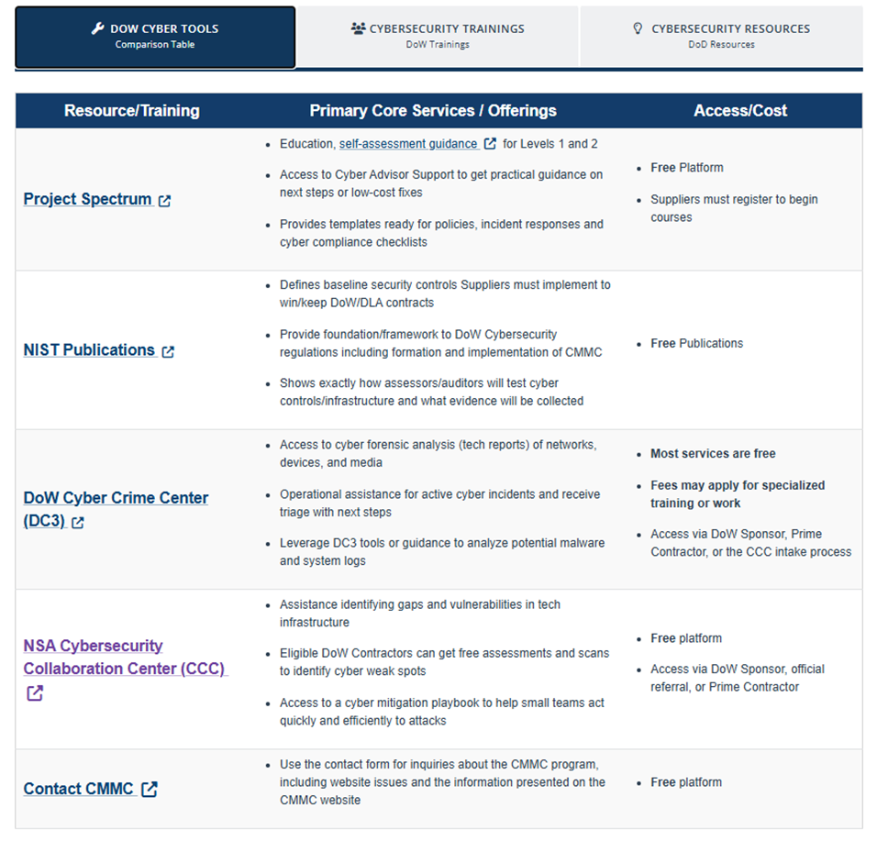
Additional Resources
Slide Classification: Classification goes here
See the lower portion of DLA Office of Small Business Programs Website:
https://www.dla.mil/Small-Business/Resource-Center/Cybersecurity-Resources/#cmmc-level-2-self-assessment-steps

